Slide 1
caArray User Community Meeting
1.5 Release Update and 2.0 Inception Activities
Call in: 877-416-5524
Participant Passcode: 2627056
Centra: http://ncicb.centra.com
Meeting ID: array_may9
May 9, 2007

Slide 2
Agenda
Introduction
1.5 Release
  What’s in it
  Release Schedule
2.0 Inception
  Why We Did It
  Where we are
  What are the expected results
  What we need from the user community

Slide 3
caArray 1.5 – Key Features
Supported array data formats will be imported as DataExternal references through caAMEL or through the user portal and will be available as BioDataCubes via the MAGE-OM API
Enhanced MAGE-OM API Search Capability
  Facilitates searches for Experiments, MeasuredBioAssays, DerivedBioAssays, as well as ArrayDesign and Reporter data
User interface for Administrator functions
Updated terminology in the user interface (ex: “BioSource” is now “Source”)
Supported expression formats:
  Affymetrix, GenePix, Agilent, Illumina, ImaGene, MAGE-ML, UCSF Spot

Slide 4
caArray 1.5 – Schedule
Production release delayed about 6 weeks
  Primarily based on additional time for QA of data parsing of all supported formats
Release is now targeted for mid-June

Slide 5
caArray 1.5.1
We are currently planning for a point release that will come out soon after 1.5
The primary feature of this release will be an array bulk loader to parse files that were submitted to caArray while parsing has been unavailable

Slide 6
caArray 2.0 Inception – Why We Did It
To make it better!
Ok, but what’s “it”
  Targeted functionality
  Usability
  Reliability
  Performance
  Supportability

Slide 7
How will Inception make it better
Reach out to the stakeholder and user community to drive requirements
Evaluate the current architecture to ensure the best elements are elevated and the weakest retired or replaced based on those requirements
Ensure we are in synch with scientific developments in the field and evolving caBIG elements

Slide 8

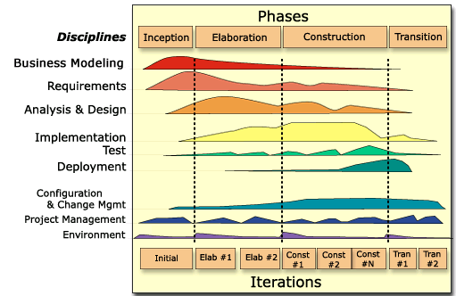
Where We Are
Inception Begun: April 4, 2007
Scheduled for completion: May 16, 2007
  Interviewed Stakeholders
  Initial Models Begun
  Documents in Draft

Slide 9
What are the expected results
Vision Document
Use Case Model and Summary
Candidate Architecture Document
An implementation thread through the Architecture
General Schedule for the 2.0 Release
Detail Schedule for the next iteration - Elaboration

Slide 10
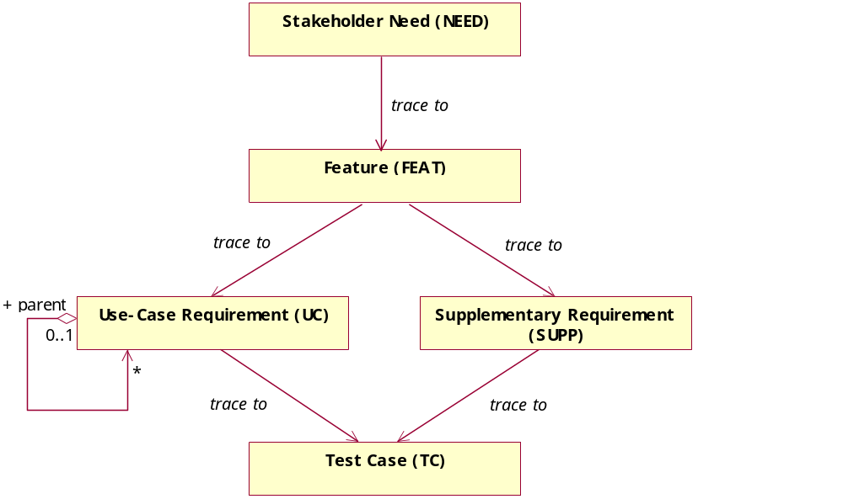
caArray 2.0 - Vision
Draft Vision – shared today
  Stakeholders Defined and Represented
  Problem Statement and the Positioning of the Product to address the Problem
  Expansive – well beyond the scope for the release of 2.0
What we need to do:
  Prioritize User Needs
  Prioritize System Features
  Determine what will be built in the next major release

Slide 11
Highlights of the Vision
Problem Statement and Positioning Statement
Anticipated Support of Platforms
Revised Organizational Structure and Roles
Introduced PI-Lab Workflow
Introduced a more granular visibility model to “project” annotation and arrays
Provide an initial evaluation of priority of needs and features

Slide 12
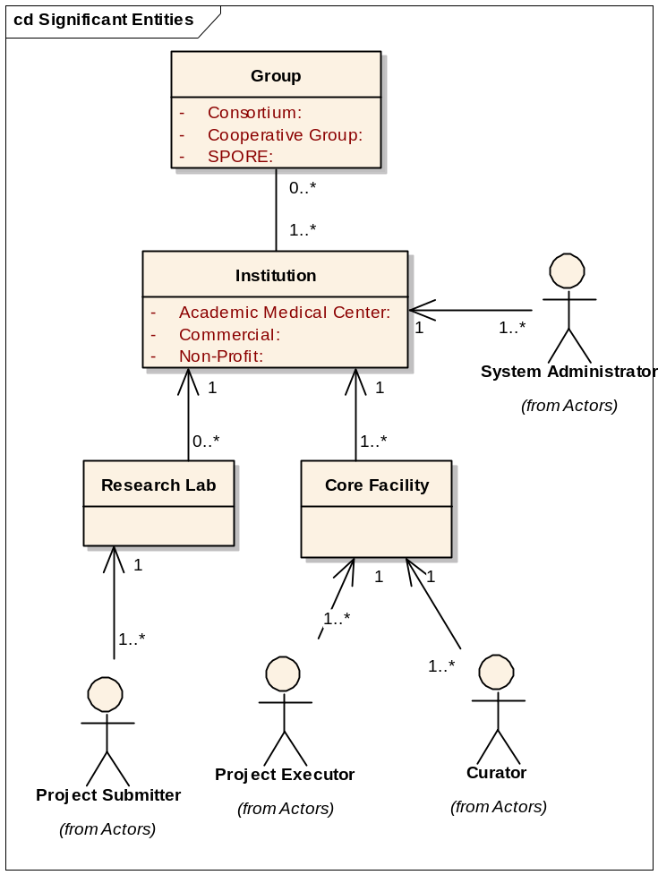
Organizational Structure

Slide 13
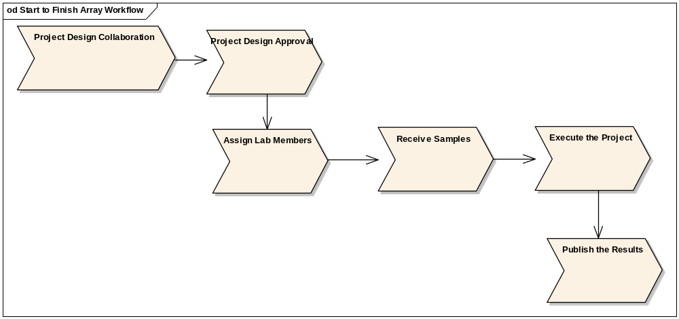
PI – Lab Workflow
Notes:
Will this apply across array platforms – gene expression, snp, aCGH

Slide 14
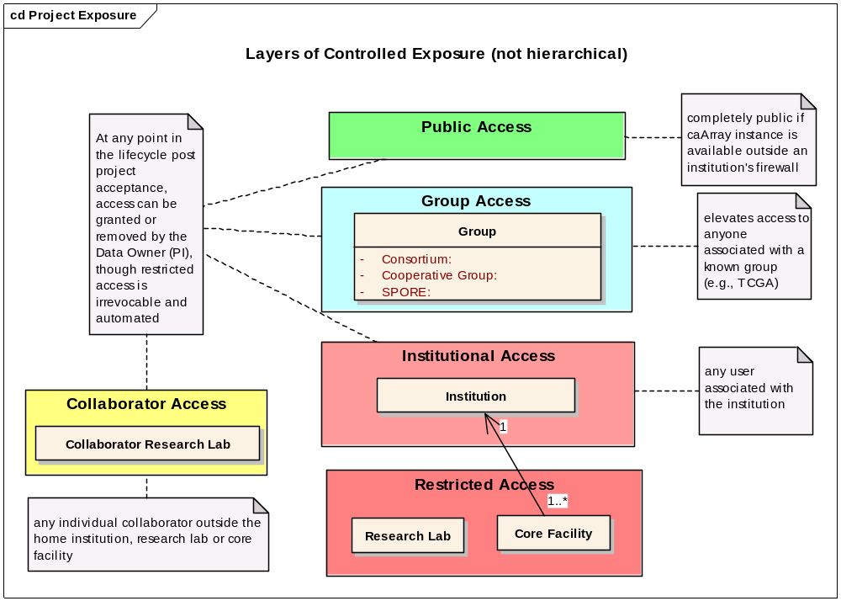
Visibility Model

Slide 15
caArray 2.0 – Use Case Model
Just to be clear –
  A use case is a sequence of actions performed by the system providing an observable result of value to a particular actor
  An actor is an external entity that directly interacts with the system
    A role a user plays
    Another system
    Time
    A device

Slide 16
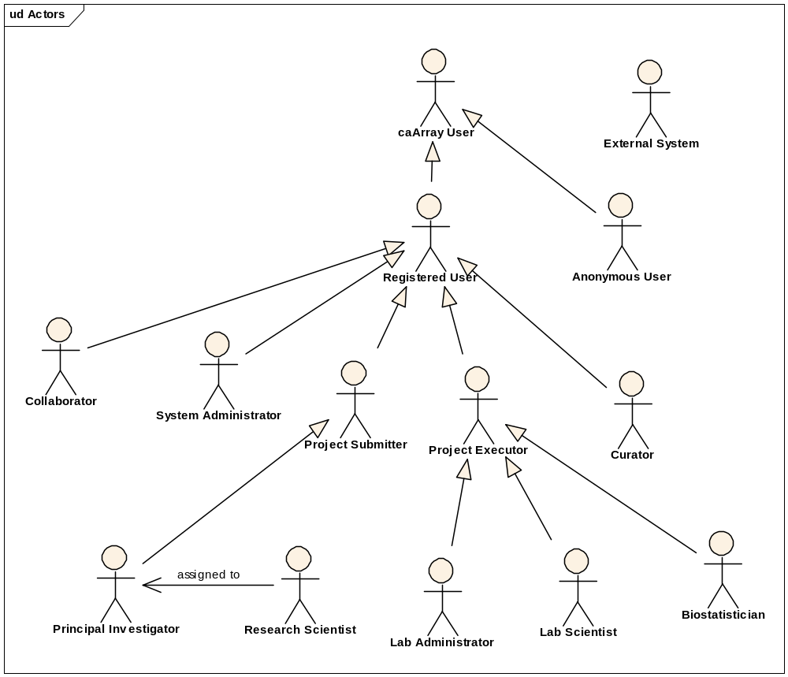
Initial Set of Actors

Slide 17
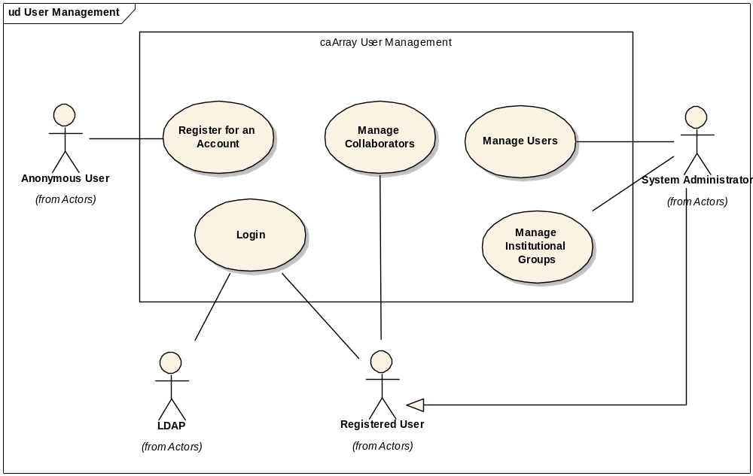
Representative Use Case Model Package

Slide 18
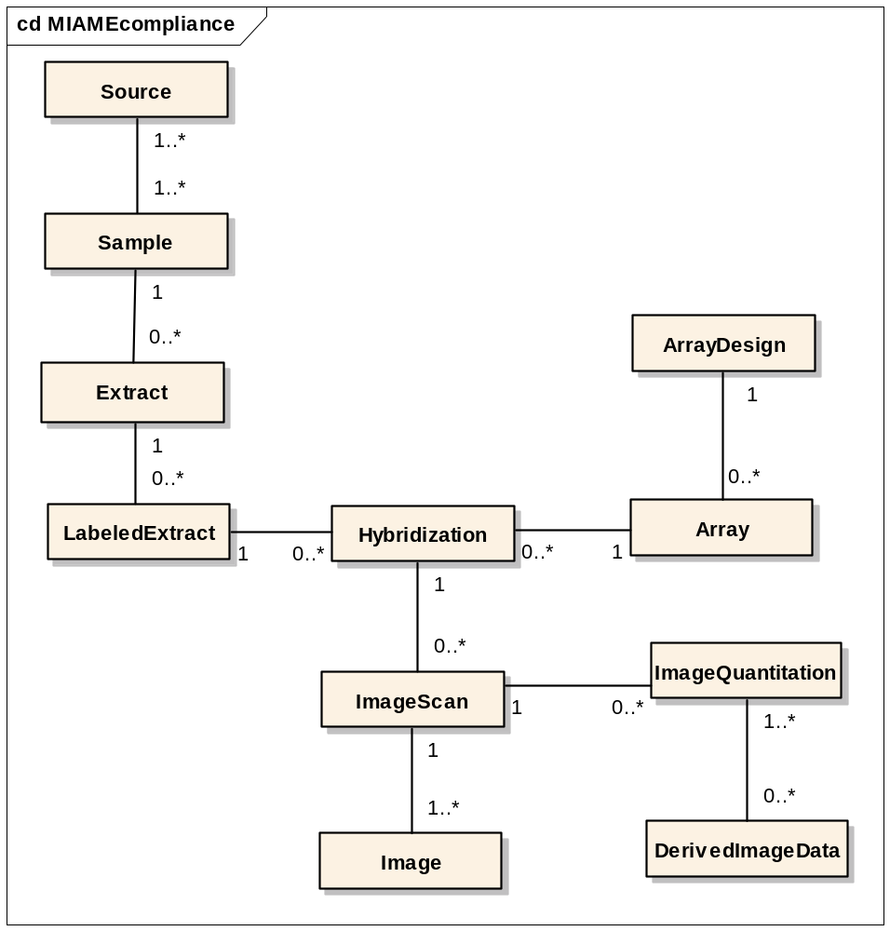
Architecture – MIAME Compliance Model

Slide 19
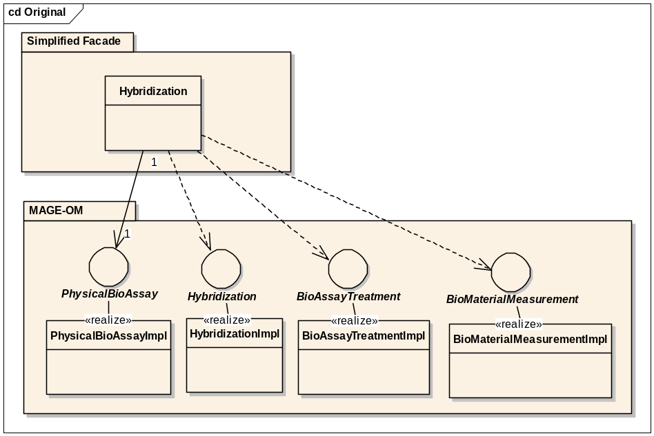
Architecture Review - Simplified Façade
Approach
  Underlying data stored as MAGE-OM objects with front-end façade classes hiding the complexity
Pros
  Simpler data migration
  Easier to implement MAGE-OM API and MAGE-ML Import
Cons
  Façade objects often require complex logic to manage underlying MAGE objects
  Difficulties getting caCORE generated classes to match existing interfaces.
  Cyclic relationships and size of MAGE model makes remote navigation of MAGE objects problematic

Slide 20
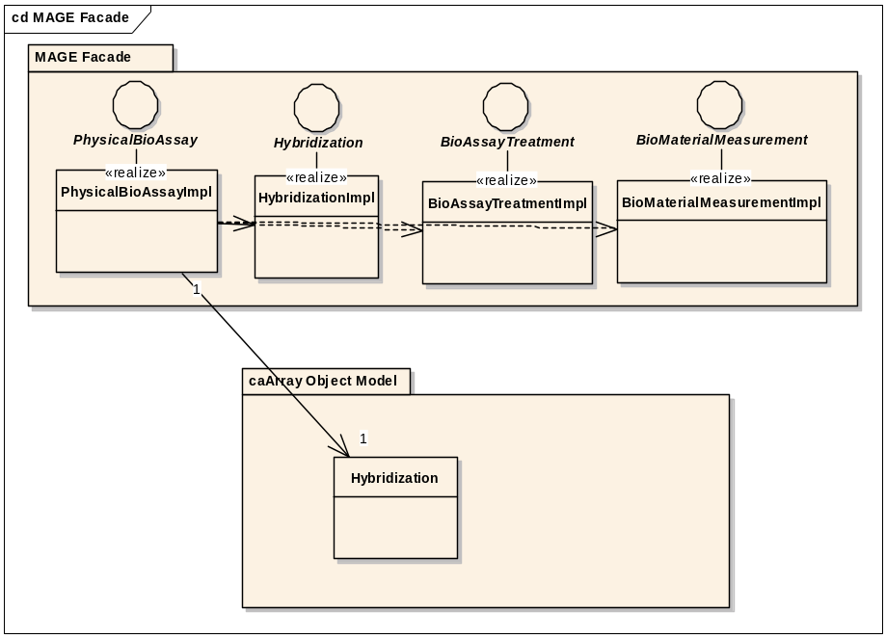
Architecture: MAGE-OM Façade
Approach
  Data managed and stored as simplified object model. MAGE-OM clients use façade objects that provide a MAGE-based view of the underlying data.
Pros
  MAGE view of simplified model relatively easy to implement
  RMI clients receive performance advantages of simplified model
Cons
  Data migration more difficult
  Can’t take advantage of code generation for MAGE-OM classes
  MAGE-ML import and grid implementation would likely need different MAGE implementation classes

Slide 21
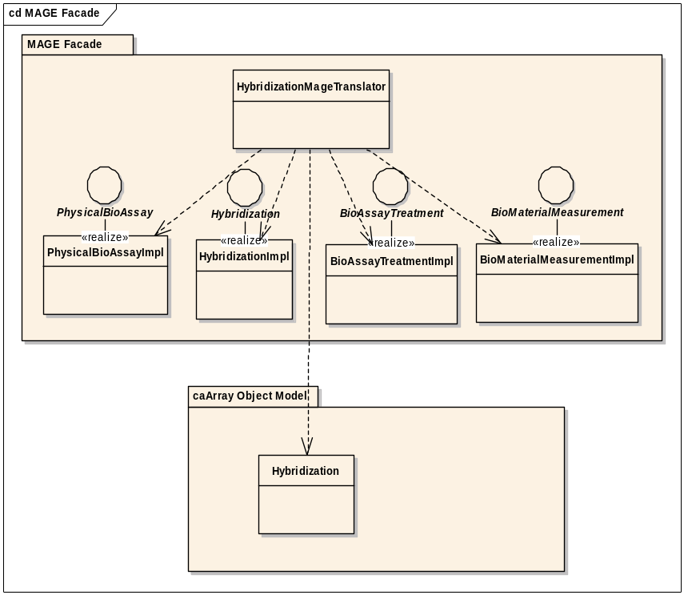
Architecture: MAGE-OM Translation
Approach
  Data managed and stored as simplified object model. Translation classes instantiate a MAGE-OM based view for clients that require it.
Pros
  Better separation of concerns
  Can use code generation tools for both simplified and MAGE-OM classes.
  MAGE classes can be used for MAGE-ML import and remote clients.
Cons
  Data migration and MAGE-ML import still more difficult to implement than if data represented in MAGE

Slide 22
What we need from you and when
You’ve provided input into the needs and features…
Now we need your input into validating the priority
  Goal: All Feedback on Needs and Features by Next Wednesday, May 16th
Targeted Questions
  MAGE-OM API vs. Simplified API – do you need both?
  Array Platforms – which are essential in the next 6 months
  Will the workflow model support those platforms?

Slide 23
How we will engage you in the future
Reconvene Monthly Meetings
Roll out a revised G-Forge site that indicates needs, features, use cases and test cases and investigate opportunities to ease collaboration
  Publish regularly and investigate forums and surveys for targeted feedback
G-forge site: https://gforge.nci.nih.gov/projects/caarray2/

Slide 24
Next Steps
Please visit G-Forge: https://gforge.nci.nih.gov/projects/caarray2/ and visit the priority survey or fill in the needs and features prioritization spreadsheet and return to Juli Klemm
Look for the published results of Inception May 17th, 2007
Next meeting date: TBA but anticipated June 6, 2007

